Slide 1
Internet Of Things
Gururajan Narasimhan

Slide 2
IOT definition
The Internet of Things (IoT) refers to a system of interrelated, internet-connected objects that are able to collect and transfer data over a wireless network without human intervention.

Slide 3
What does IOT do ?
The Internet of Things (IoT) is at the center of the Digital Transformation Revolution that is changing the shape of business, enterprise and people’s lives.
This transformation influences everything from how we manage and operate our homes to automating processes across nearly all industries

Slide 4
IoT has branched in to many
Internet of Military Things – IoMT
Internet of Battlefield Things – IoBT
Internet of Security Things – IoST (Home land security)
Internet of Industrial Things – IoIT
Internet of Health Things – IoHT
Internet of Home Networking Things - IoHNT

Slide 5
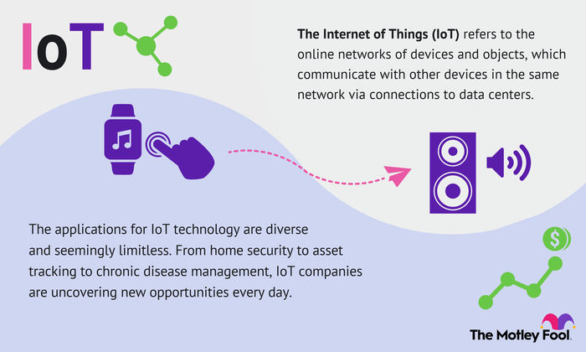

Slide 6
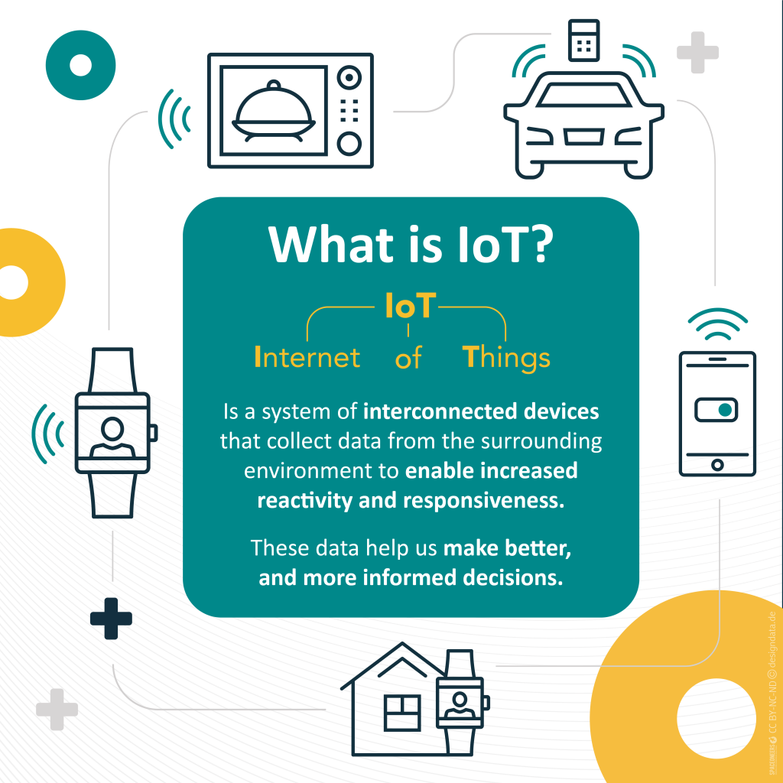
Top 5 companies doing IOT
IBM
Microsoft
Intel
Cisco
Google

Slide 7
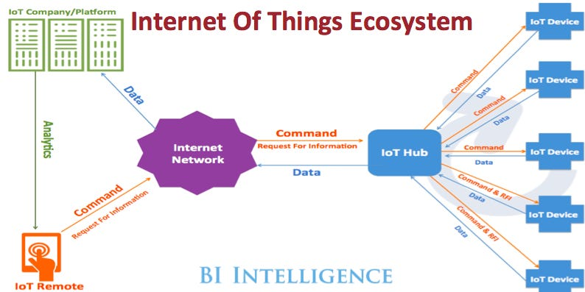

Slide 8
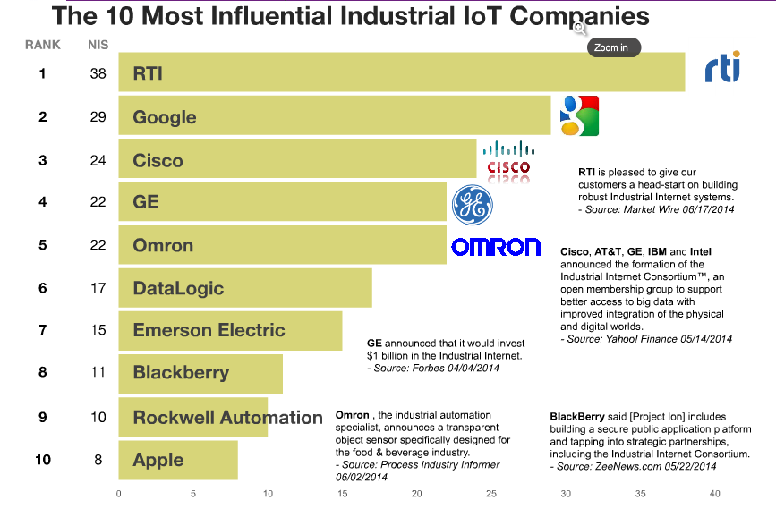

Slide 9
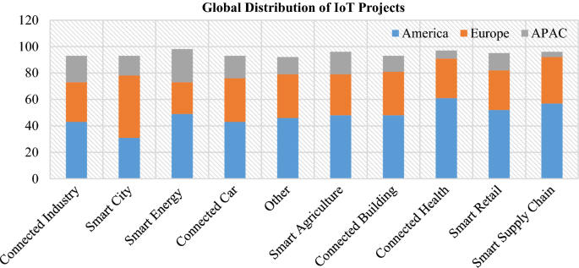

Slide 10
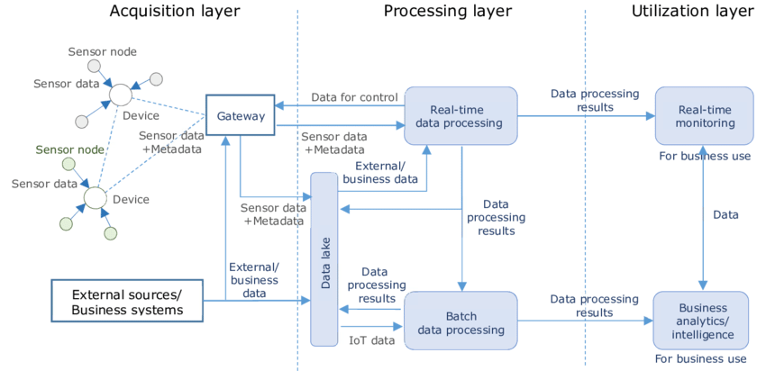

Slide 11
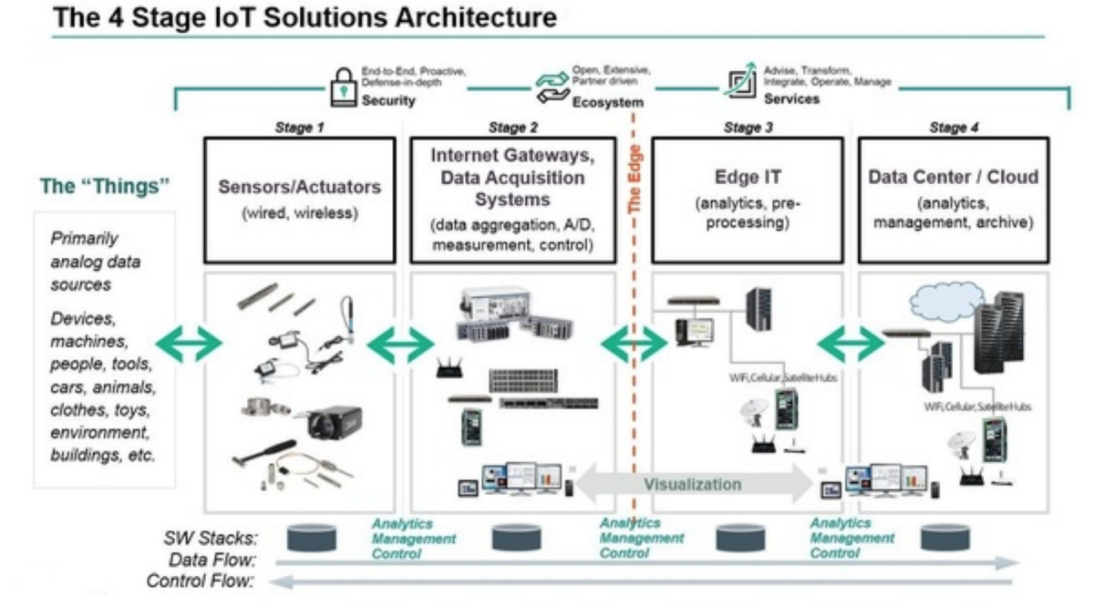

Slide 12
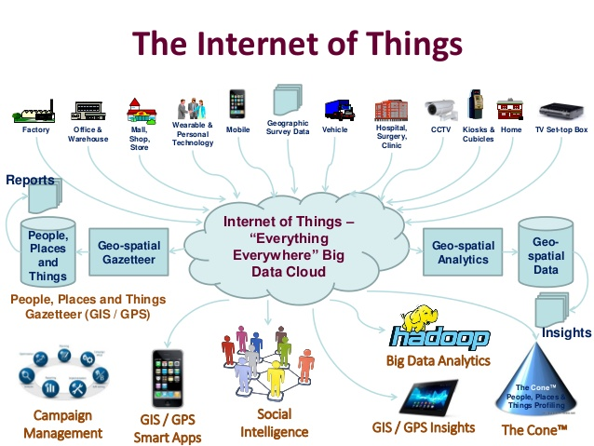

Slide 13
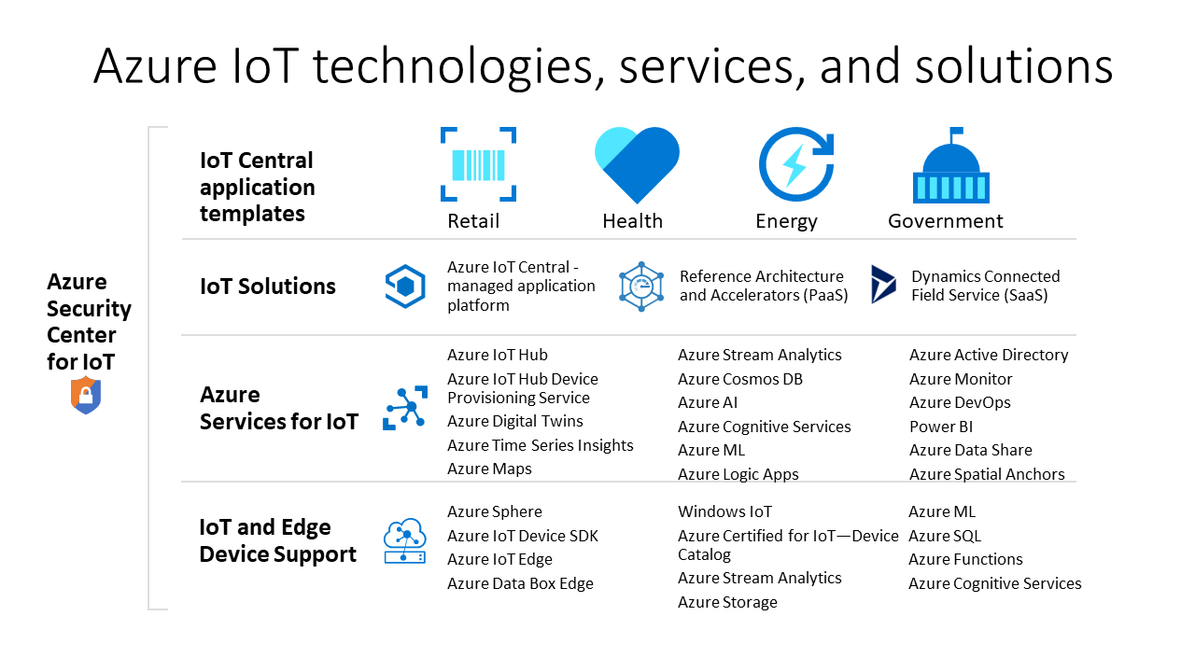

Slide 14
